Slide 1

Table of Contents
Information of Beanie
Step-to-step guide
Beanie choices
Style A
Style B
Style C
Free Style
Specification(Example)
Specification(Your design)
Checklist

Slide 2
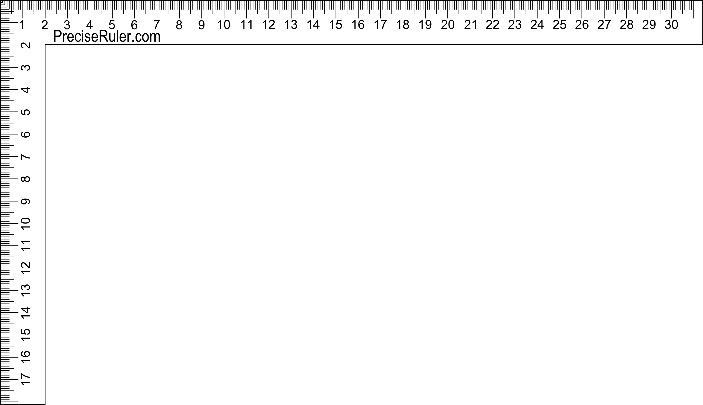
Beanie Size: 22cm (h) x 24cm (w)
Material: 100% Acrylic
Pom Pom
(max: 3 colours)
Movable ruler
Knitted text
TEAM NAME
Embroidery logo
(Max height: 5.5cm)
Roll up
PLACELOGO HERE
Information
of Beanie

Slide 3

Step-to-step guide
How to submit your design to us
Double click to open

Slide 4
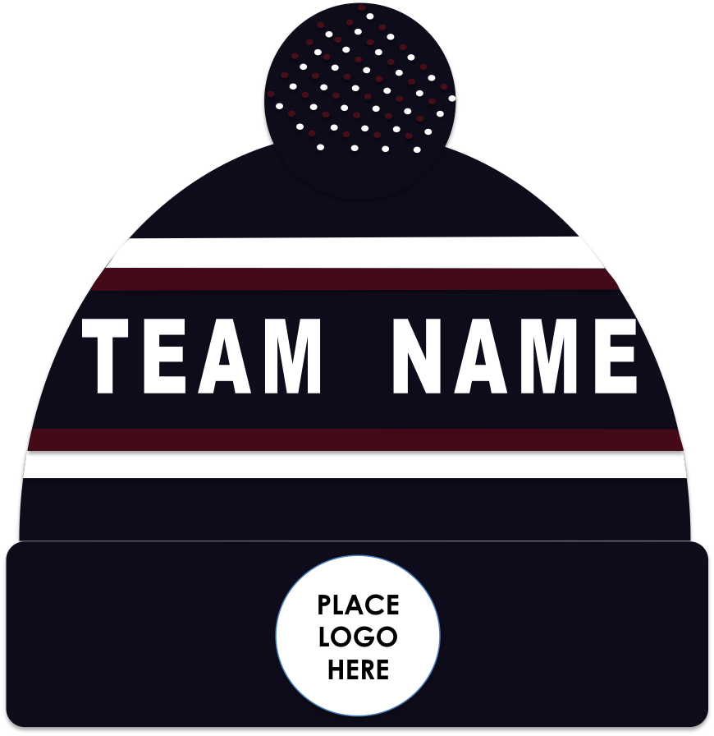

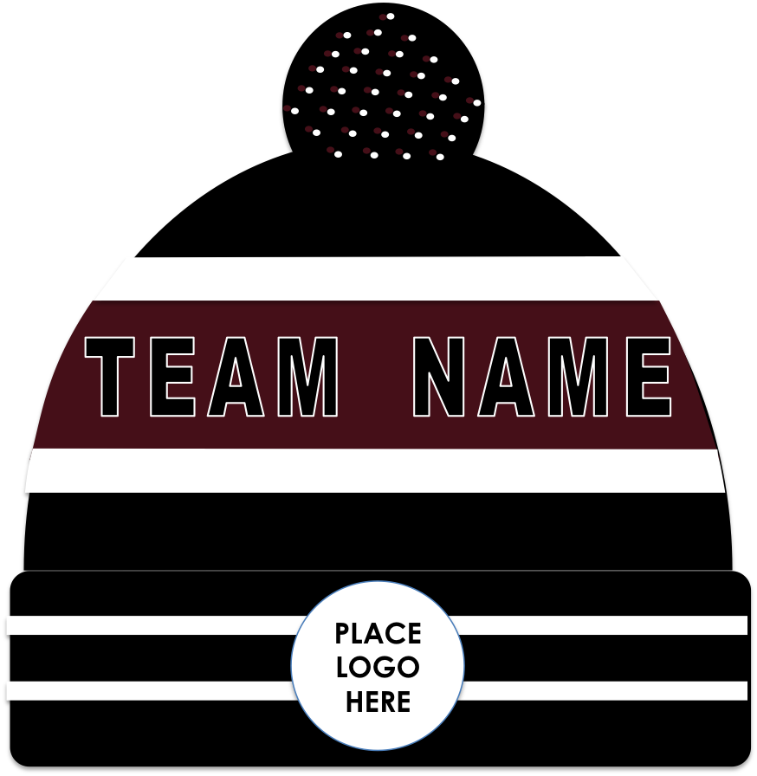

MAKE YOUR OWN DESIGN
Based On Our Popular Styles
Style A
Style B
Style C
Or…
Already have a design?
Click here

Slide 5
BEANIE TEMPLATE
TEAM NAME
PLACELOGO HERE
Style A

Slide 6
BEANIE TEMPLATE
PLACELOGO HERE
Style B

Slide 7
BEANIE TEMPLATE
TEAM NAME
PLACELOGO HERE
Style C

Slide 8
If you already have a design, simply add the picture here
(please make sure
your design is made
according to scale,
like this one)
BEANIE TEMPLATE
Free style

Slide 9



Specification (Example)
Team name
Logo
Warriors
Quantity
60 pcs
(Enter at least 50pcs)
Pom Pom
(maximum : 3 colors)
Navy
Red
Style: Embroidery logo
Size(height): 5cm
Please make sure the text on the logo is not too small, otherwise the factory would remove it
Text
Side Logo (Yes/No)*
Yarn colours
(maximum: 4 colours)
Navy
Red
White
Paste logo here if applicable
Colour: White
Font name:
Style: Embroidery logo
Position: Left/ right*
Size(height):
*delete where appropriate
Notes:
9

Slide 10
Specification (Your design)
Team name
Logo
Paste your logo here
Quantity
Paste your design here
______pcs
(Enter at least 50pcs)
Pom Pom
(maximum : 3 colors)
(1)
(2)
(3)
Style: Embroidery logo
Size(height):
Please make sure the text on the logo is not too small, otherwise the factory would remove it
Text
Side Logo (Yes/No)*
Yarn colours
(maximum: 4 colours)
(1)
(2)
(3)
Paste logo here
if applicable
Colour:
Font name:
Style: Embroidery logo
Position: Left/ right*
Size(height):
*delete where appropriate
Notes:
10

Slide 11

Checklist
Your design
Fill in all information on the Specification (your design) slide
Fill in the Excel order form
and save the file
Next step: Send an email to naomi.chan@evigtro.com.hk
with the following files:
This PowerPoint
Your logos (PDF/PSD/Ai format)
The font file (ttf/oft format)
→
(double click to open)

